Slide 1
Talk Data Mobile User Analytics
By
Ramasubramanian Subramanian
03/01/2024

Slide 2
Overview and problem statement
The purpose of this product is to classify population depending on their uses of their phone and phone brands. This classification is the first step to tailor advertising campaigns by third parties based on the usage of the mobile according to the age and gender of the population.
For this we have a sample of the population using Mobile Talk data in China. Although this product has been developed for the Chinese population, it can be used globally as further research has shown that other mobile operators in other countries have access to the same type of data.
The purpose of this task is to build a model predicting users’ demographic characteristics based on their app usage, geolocation, and mobile device properties. Doing so will help millions of developers and brand advertisers around the world pursue data-driven marketing efforts which are relevant to their users and catered to their preferences.

Slide 3
Data analyzed
In this experiment, I will explore Talking Data Mobile User Demographics Analytics.
The dataset is comprised of customer data and customer attrition status gained from IBM customers. Customers who have stopped doing business with IBM are listed in our target variable 'Churn' and assigned a 'Yes' value indicating customer attrition.
Our goal is to create a machine learning model that will predict the target variable Gender Age group and test which machine learning model performs best with our data using various classification metrics
Dataset Link: https://www.kaggle.com/c/talkingdata-mobile-user-demographics

Slide 4
Approach
Data Exploration
Class Balancing
Deep Learning Models:
Artificial Neural Network(ANN)
Convolutional Neural Network (CNN)
Supervised Models: (based on Kbest and PCA feature Selection approach)
Logistic Classification
KNN Classification
Decision Tree
Support Vector Classification
Random Forest
UnSupervised Models:
KMeans Clustering with PCA feature selection
GMM Clustering with t-SNE feature selection
Run the models with different hyperparameters to find the best performance
Evaluate the model performance based on Accuracy Score, Classification Report, Cross Validation Score and Confusion Matrix

Slide 5
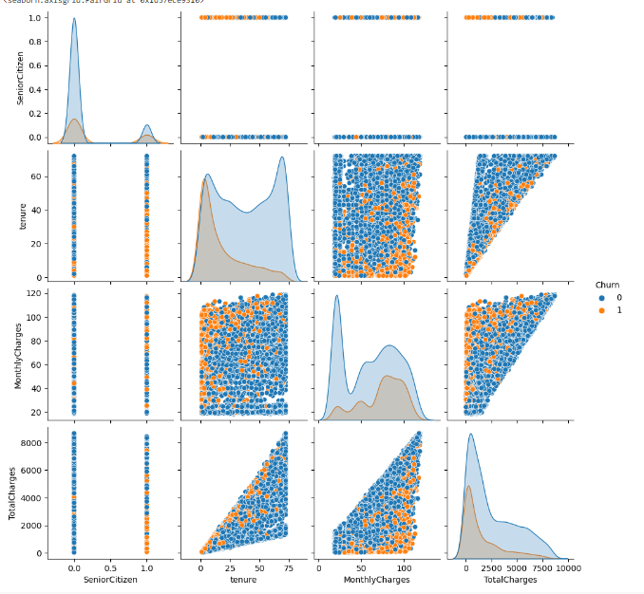
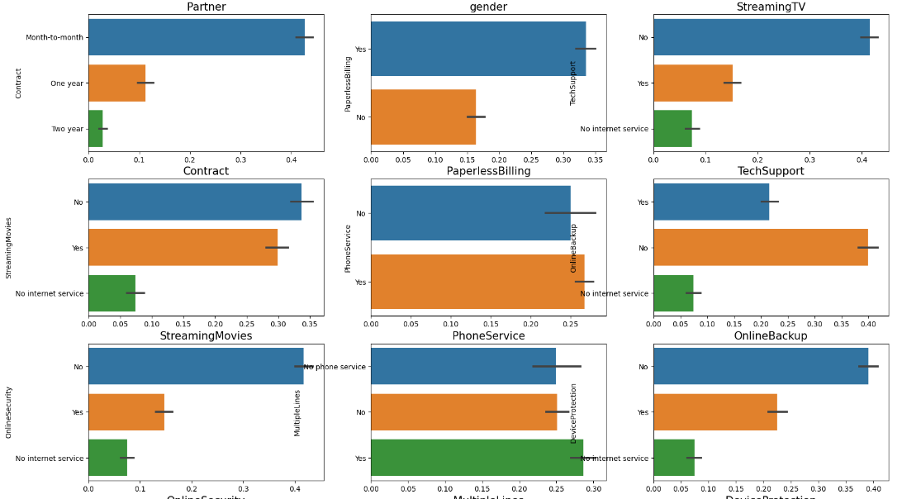
Implementation Steps
Data Exploration
Drop ‘na’ values
Replace null values with mean
Convert the columns into correct data type
Remove unique columns
Understand the data distribution
Encoding the categorical data
Standardize the values to one scale

Slide 6
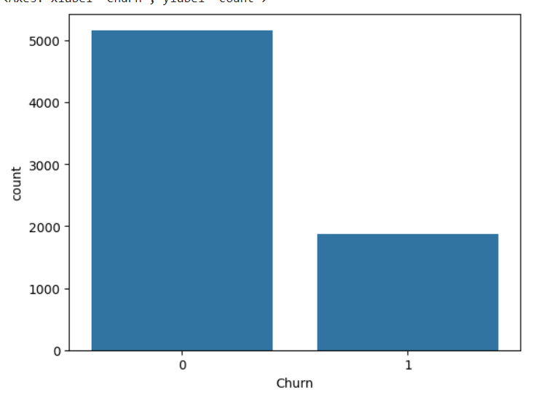
Implementation Steps
Class Balancing
The data is not balanced. There are around 5000 records for Churn ‘No’ and 2000 records for Churn ‘Yes’.
The model will give biased result if the data is not balanced so used ‘Stratify’ method to balance this data during splitting the dataset for train and test.

Slide 7
Implementation Steps
Model Execution
Split the train and test dataset by 33% test size
Run the below Classification Models through both PCA and Kbest Feature selection approach with Gridsearch CV to find the best hyperparameters for the model
Decision Tree Model
KNN (K Nearest Neighbor) Model
Random Forest Model
SVC (Support Vector Classifier) Model
Logistic Regression Classifier Model

Slide 8
Implementation Steps
Model Evaluation
Evaluate the model performance based on Accuracy Score, Classification Report, Cross Validation Score and Confusion Matrix
Accuracy Score: Function computes the subset accuracy. Comparing the prediction vs actual value
Classification Report: Text report showing the main classification metrics
Precision: Percentage of correct positive predictions relative to total positive predictions
Recall: Percentage of correct positive predictions relative to total actual positives
F1 Score: Combination of Precision and Recall
Cross Validation Score: Evaluate the model score by cross validation
Confusion Matrix: Table with two rows and two columns that reports the number of true positives, false negatives, false positives, and true negatives

Slide 9
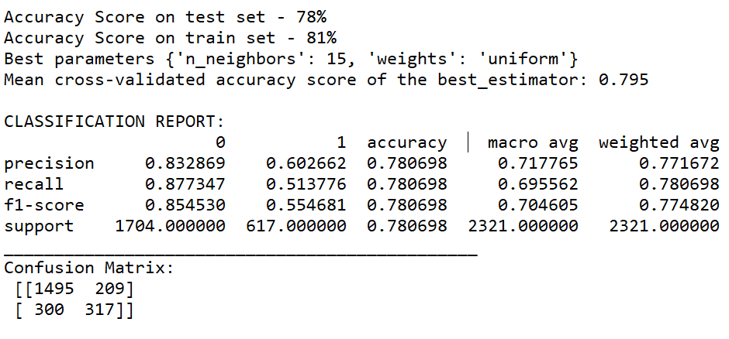
Conclusion
As part of this exercise, we have run the Logistic Regression, KNN, SVC, Decision Tree, Random Forest models based on two features selection methods, Kbest and PCA.
The KNN model based on Kbest feature selection model performed very well compared to others so which can considered to predict the potential customer churn with a model accuracy of 79% with parameters 'n_neighbors': 10, 'weights': 'uniform'
https://colab.research.google.com/drive/1HQgwXjJBwXk7i-kc6tBw1l8qFPhdpqrT#scrollTo=da1fdca6

Slide 10
Questions?

Slide 11
Thank You

